Slide 1
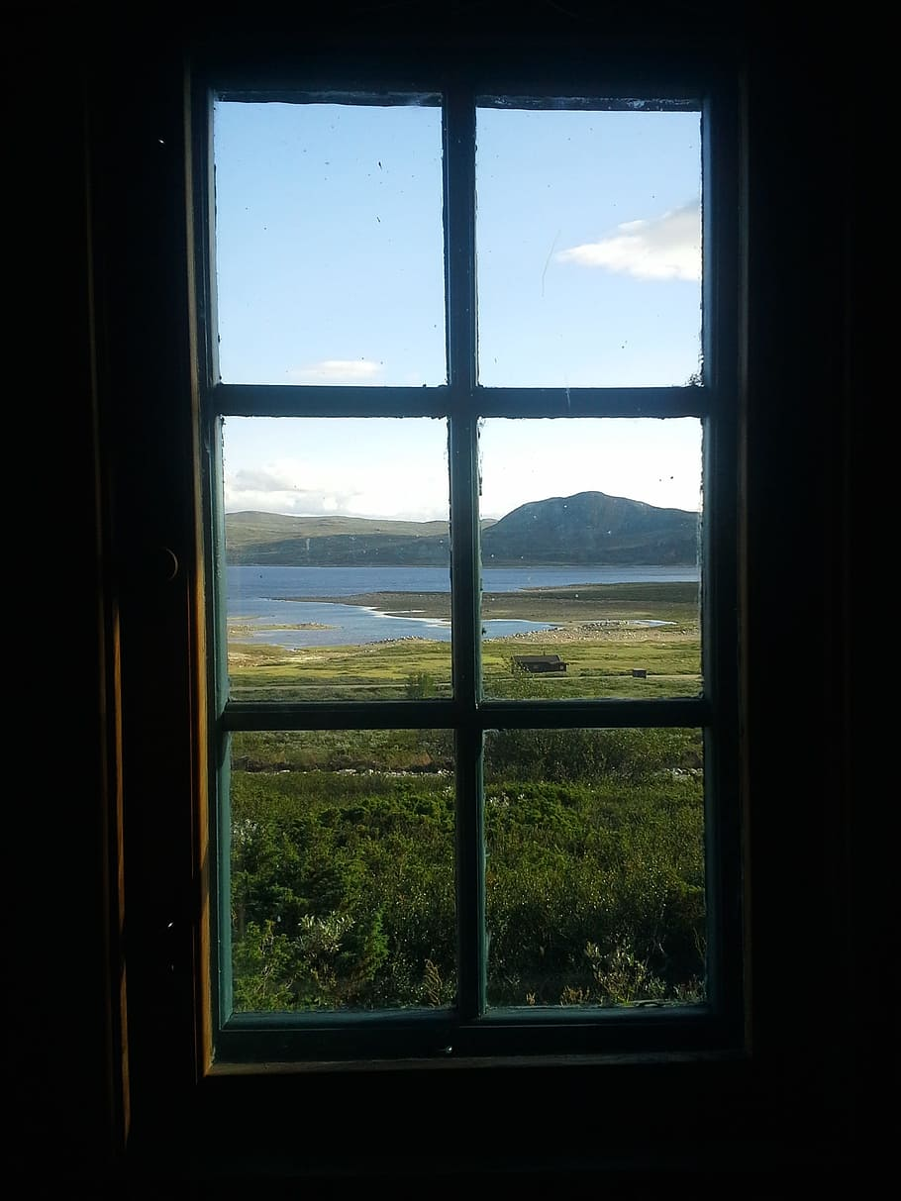
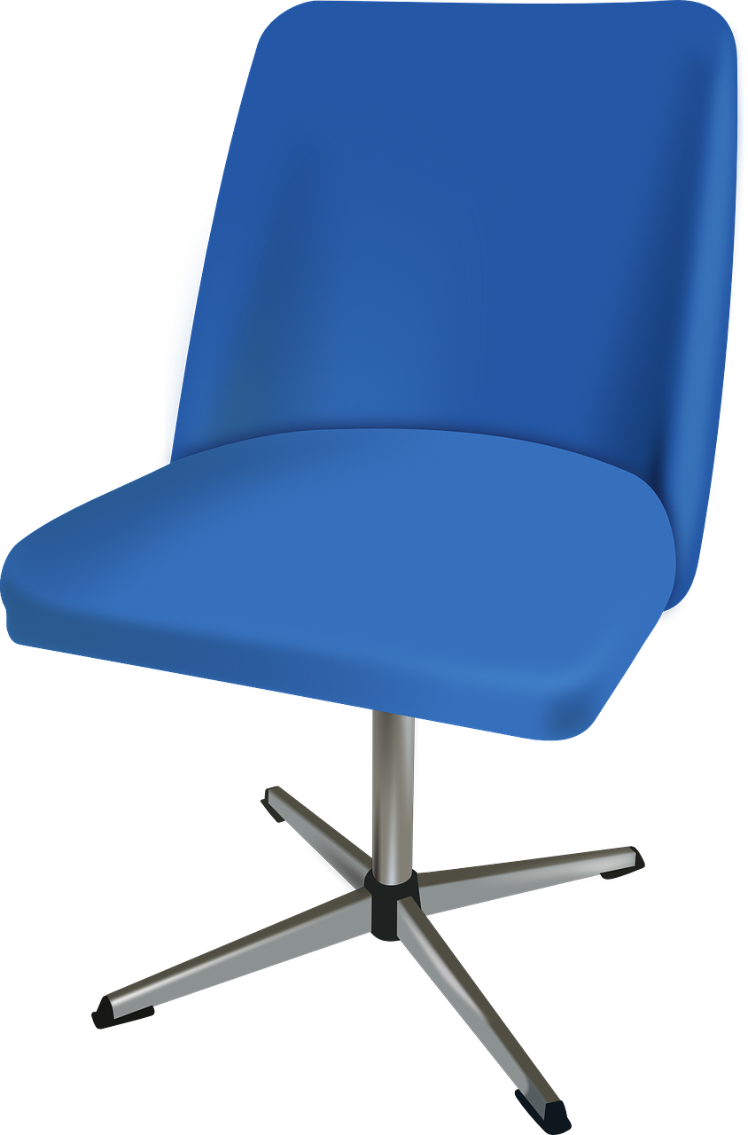
Welcome to
Mrs. Krumsieg’s Office!
Hover your mouse over the items on the shelf to explore my favorite stories and social emotional learning activities.
Mason Website
Lexington Website
TEAMS Page

